Slide 1
Little Language
Design Pattern

Slide 2
Building a Simple Search Expression Language
I want to create a little language that will allow my users to express a simple search query.
Here are some examples of the types of queries that I want my users to be able to express
fox: match any string containing the word “fox”.
fox and not (brown or black): match any string containing the word fox, but not containing the word “brown” or the word “black”
“little red fox” and road: match any string containing the phrase “little red fox” and the word “road”.
I want to design my search tool so that it performs case-sensitive search, but is also capable of performing case-insensitive searches.

Slide 3
Building a Simple Search Expression Language
I could use code generation tools like Lex and Yacc for C, or Antlr for Java, but for a language this simple, it would be easier to code a parser by hand.
Creating a simple parser by hand gives me the following benefits:
better control over the structure and behavior of the resulting code.
makes it easier to maintain the code.
knowledge of how to create parsers in languages for which there are no parser generators (e.g. JavaScript)
Knowing how to create a simple parser by hand also makes it easier to understand and customize the behavior of parser generators, which is useful for when you want to tackle a more complex DSL.

Slide 4
Grammar in Backus-Naur Form (BNF)
A grammar defines the rules (a.k.a. productions) of the language syntax in terms of terminal and non-terminal symbols. Operator precedence is NOT, AND, OR.
expression -> orExpression
orExpression -> andExpression or orExpression
orExpression -> andExpression
andExpression -> notExpression and andExpression
andExpression -> notExpression
notExpression -> not simpleExpression
notExpression -> simpleExpression
simpleExpression -> ( orExpression )
simpleExpression -> word
simpleExpression -> quoted_string

Slide 5
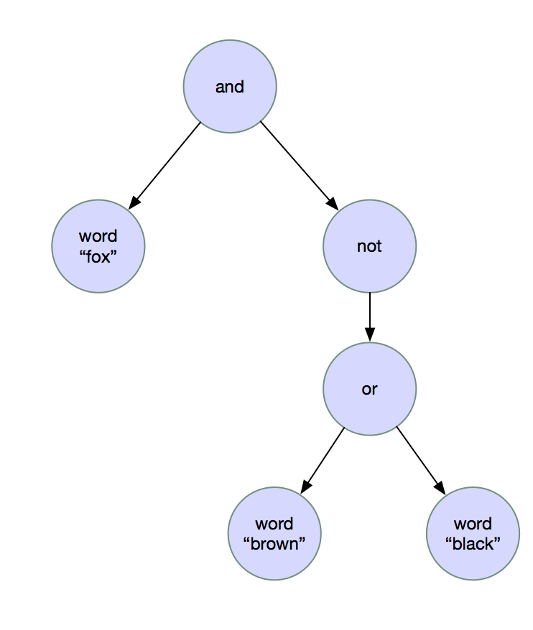
Syntax Trees
fox and not (brown or black)

Slide 6
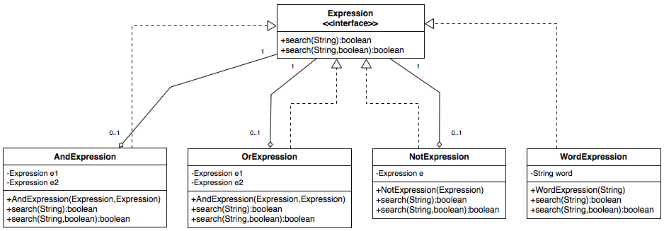
Object Model: Composite Pattern

Slide 7
Object Model: Composite Pattern
fox and not (brown or black)
Expression e = new AndExpression(
new WordExpression("fox"),
new NotExpression(
new OrExpression(
new WordExpression("brown"),
new WordExpression("black")
)
)
);
if (e.search(“The red fox raced across the road“)) {
System.out.println(“The specified string satifies the search expression“);
} else {
System.out.println(“The specified string does not satisfy the search expression“);
}

Slide 8
Building a Little Language Parser
The goal of our parser is to convert a string representing an expression such as “fox and not (brown or black)” into a composite object like the one we created programmatically in the previous slide.
The little language parser will be subdivided into two separate processes:
Lexical Analyzer: converts a sequence of characters into a sequence of language-specific terminal symbols.
Parser: converts a sequence of terminal symbols into a composite object.

Slide 9
Lexical Analyzer
Accepts a sequence of characters and converts them into a sequence of terminal symbols (a.k.a. tokens).
Each token has a type which can be expressed as a regular expression and a lexeme, which is the string that matched the regular expression for the token in question.
Token Types: AND, OR, NOT, LEFT_PAREN, RIGHT_PAREN, WORD, QUOTED_STRING, EOF
For an expression such as: “fox and not (brown or black)”, the sequence of tokens produced by consecutive calls to lexer.nextToken() are:
Token {type=WORD, lexeme=“fox”}
Token {type=AND, lexeme=“and”}
Token {type=NOT, lexeme=“not”}
Token {type=LEFT_PAREN, lexeme=“(”}
Token {type=WORD, lexeme=“brown”}
Token {type=OR, lexeme=“or”}
Token {type=WORD, lexeme=“black”}
Token {type=RIGHT_PAREN, lexeme=“)”}
Token {type=EOF, lexeme=null}

Slide 10
Parser
Uses a LexicalAnalyzer and top-down recursive descent to convert the tokens into a composite object based on the syntax rules defined for the grammar.

